Slide 1
Supermart Grocery Sales - Retail Analytics Dataset

Slide 2
Purpose
Objective
The goal of the project, titled "Supermart Grocery Sales - Machine Learning Project," is to use this dataset to build a machine learning model for predicting sales or profit
This fictional dataset is intended to help data analysts practice exploratory data analysis (EDA) and data visualization. It simulates grocery orders placed by customers in Tamil Nadu, India, through a delivery application.

Slide 3
Details of Data
Source: Fictional dataset created to aid data analysts in practicing exploratory data analysis (EDA) and data visualization. It contains information on orders placed by customers on a grocery delivery application, specifically designed with the assumption that all customers reside in Tamil Nadu, India.
2. Dataset-Related Information:
Order ID and Customer Details: Each order is uniquely identified with details like customer name.
Product Categories: Columns include Category and Sub Category, indicating types of products ordered.
3. Shape: The dataset contains a wide variety of features, making it ideal for learning how to work with real-world retail data.

Slide 4
Data Cleaning and Preprocessing
Steps to Follow:
Data Loading and Initial Exploration: Loaded the dataset and reviewed basic statistics and data structure.
Actions Taken: Displayed the first few rows, calculated summary statistics, and checked data types and non-null values.
Data Cleaning:
Identified and handled missing values.
Actions Taken: Checked for missing values in each column and filled them with 'Unknown' to prepare the data for analysis.

Slide 5
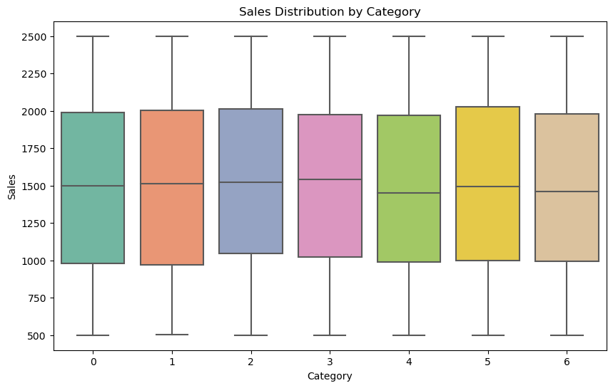
Distribution of Sales by Category

Slide 6
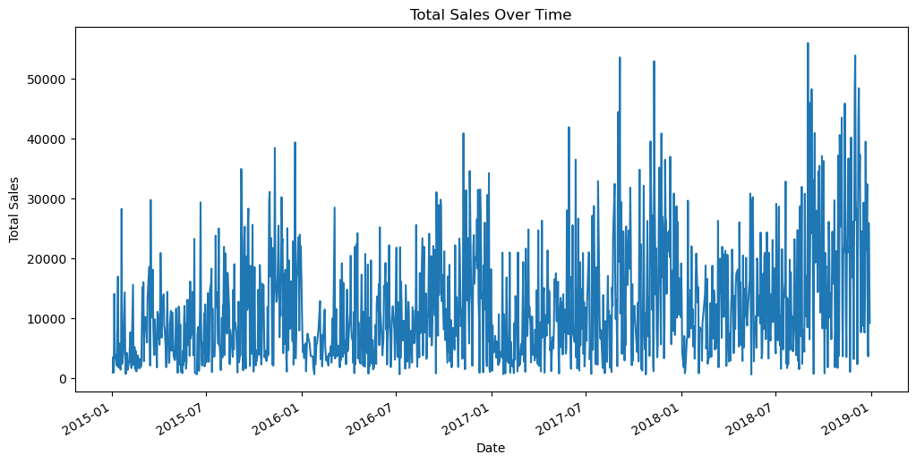
Sales Trends Over Time
.

Slide 7
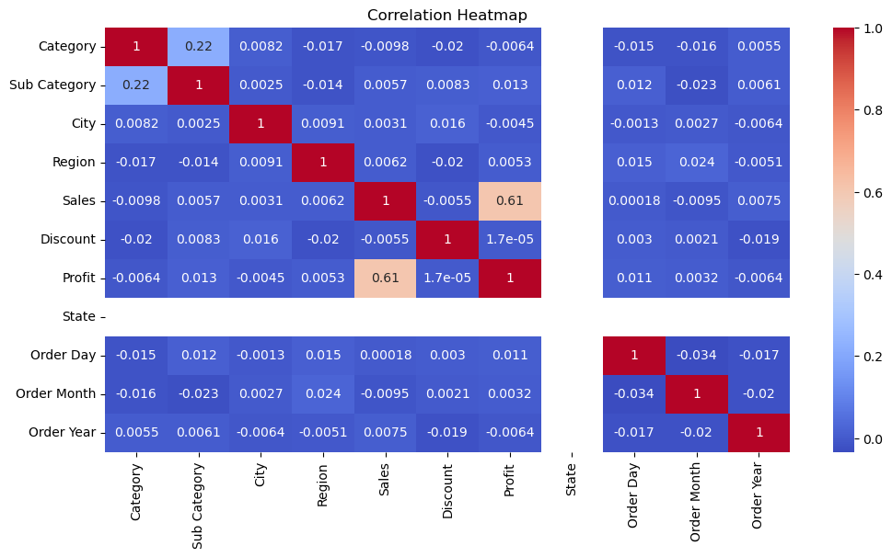
Correlation Heatmap

Slide 8
Feature Selection and Model Building
1. Feature and Target Selection:
The dataset was processed to select relevant features for modeling. The features used were all columns except
for Order ID, Customer Name, and Order Date, with Sales designated as the target variable.
2. Data Splitting:
The data was split into training and testing sets using an 80/20 split. This means 80% of the data was
used for training the model, while 20% was reserved for evaluating its performance.
3. Feature Scaling:
Standardization was applied to the features using Standard Scaler.
This process ensures that the model performs optimally by normalizing the feature values to have a mean of 0 and a standard deviation of 1.

Slide 9
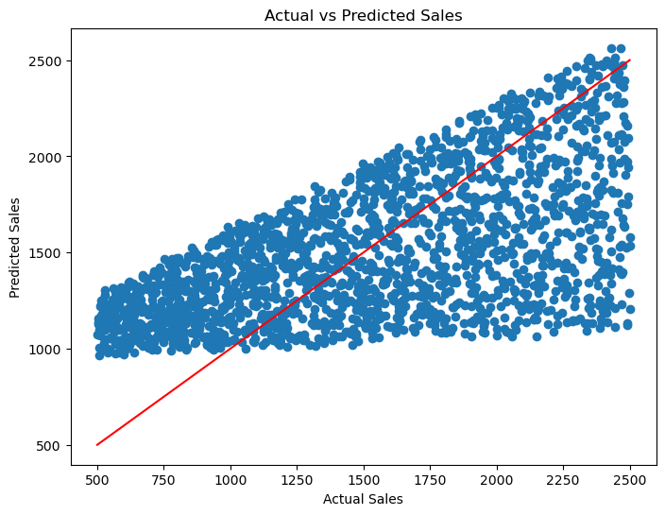
Visualize the Results

Slide 10
Thank you

